Slide 1
Server and Database Principals

Slide 2

About the Author
Created By:
Credential Information:
Version and Date: | SS2008/0611/1.0
Cognizant Certified Official Curriculum

Slide 3









Icons Used
Hands on Exercise
Questions
Tools
Coding Standards
Test Your Understanding
Reference
A Welcome Break
Contacts
Demonstration

Slide 4
Objective
Creating a server and database principal

Slide 5
Principals
Principals are entities that can request SQL Server resources
The scope of influence of a principal depends on the scope of the definition of the principal:
Server
Database

Slide 6
Login vs. User
LOGIN | USER
Instance level | Database level
Used for user authentication | Used for database access
Notes:
Although the terms login and user are often used interchangeably, they are very different.
A login is used for user authentication
A database user account is used for database access and permissions validation.
The process of verifying that a particular login is valid is called "authentication". This login must be associated to a SQL Server database user. You use the user account to control activities performed in the database. If no user account exists in a database for a specific login, the user that is using that login cannot access the database even though the user may be able to connect to SQL Server.

Slide 7
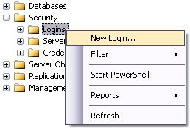
Create a user login
Notes:
Using SQL Server Management Studio, expand the "Security" option and right click on "Logins"

Slide 8
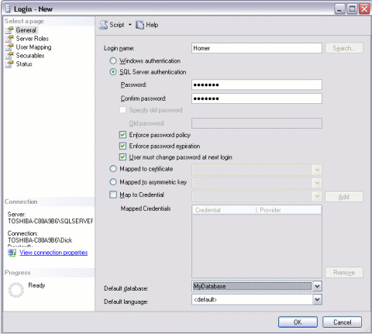
General
Specify the Authentication mode
Notes:
Complete the login properties in the "General" tab by providing a name for the login, choosing the Authentication method (providing a password if you choose "SQL Server authentication"), and selecting the database to use as a default.
When password complexity policy is enforced, new passwords must meet the following guidelines:
The password does not contain all or part of the account name of the user. Part of an account name is defined as three or more consecutive alphanumeric characters delimited on both ends by white space such as space, tab, and return, or any of the following characters: comma (,), period (.), hyphen (-), underscore (_), or number sign (#).
The password is at least eight characters long.
The password contains characters from three of the following four categories:
Latin uppercase letters (A through Z)
Latin lowercase letters (a through z)
Base 10 digits (0 through 9)
Non-alphanumeric characters such as: exclamation point (!), dollar sign ($), number sign (#), or percent (%).
Passwords can be up to 128 characters long. You should use passwords that are as long and complex as possible.

Slide 9
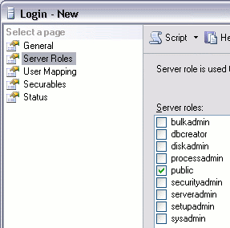
Server Roles
Grant server-wide permissions to a login
Choose server roles
Notes:
Click the "Server Roles" tab if you need to apply any server-wide security privileges
Server roles are available for various database administration tasks. Not everyone should be assigned to a server role. In fact, only advanced users such as database administrators should be assigned a server role.

Slide 10
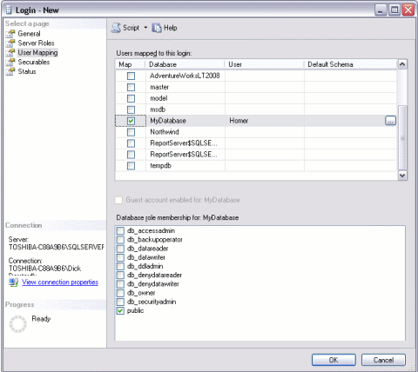
User Mapping
Specify which database the login can access
Choose database roles
Notes:
Click the "User Mapping" tab to specify which databases this user account is allowed to access. By default, the login will be assigned to the "Public" role, which provides the login with basic access. If the login needs more access in one or more databases, it can be assigned to another role with greater privileges.

Slide 11
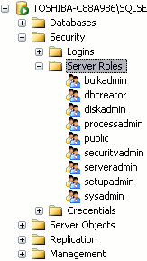
Server Roles
Can create, alter, drop, and restore any database
Can set server-wide configuration options
Can perform any task in SQL Server

Slide 12
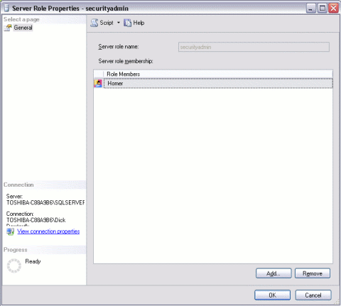
Server Role Properties
Notes:
You view the properties of a server role by right clicking on it. You can then add users to the server role by clicking Add.

Slide 13
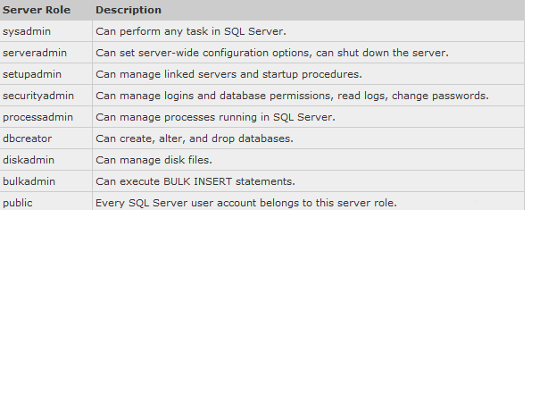
Server Roles

Slide 14
Database Roles
Database-level role | Description
db_owner | can perform all configuration and maintenance activities on the database, and can also drop the database
db_datawriter | can add, delete, or change data in all user tables
db_datareader | can read all data from all user tables
db_backupoperator | can back up the database

Slide 15
T-SQL Syntax
CREATE LOGIN login_name WITH PASSWORD = '340$Uuxwp7Mcxo7Khy‘
CREATE USER user_name FOR LOGIN login_name;

Slide 16
Questions

Slide 17
Summary
A login is a security principal, or an entity that can be authenticated by a secure system
Users need a login to connect to SQL Server

